Slide 1
Sharing Content Selectively
17 October 2011

Slide 2
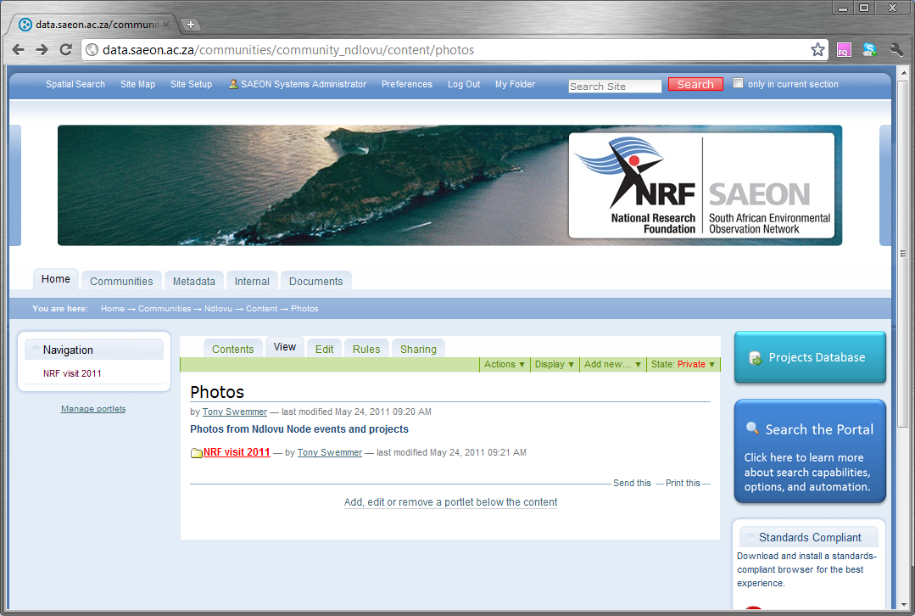
Any content can be shared selectively
Folder contains content to be shared
The folder is currently private

Slide 3
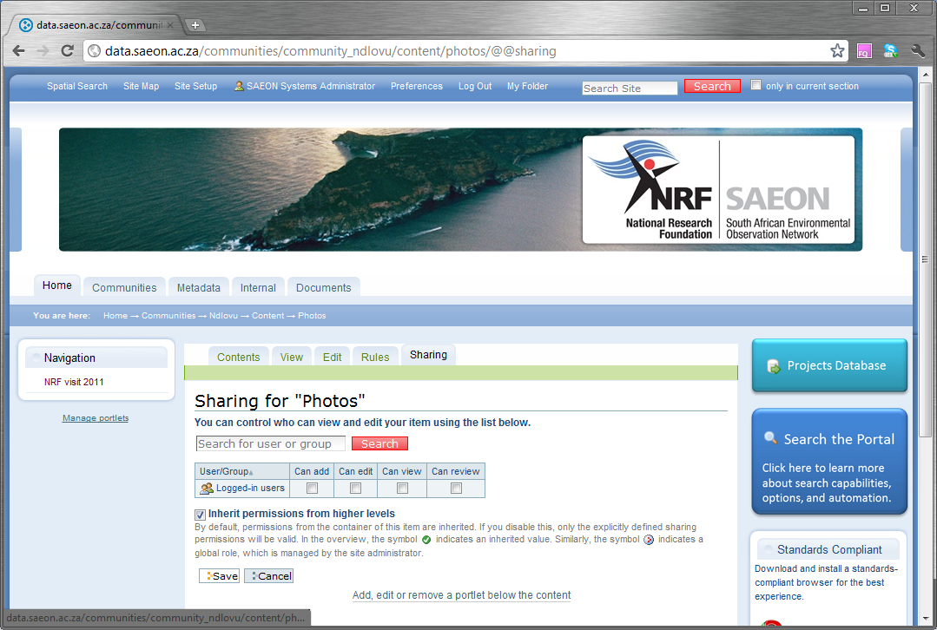
Content Owners can click on ‘Sharing’ tab.
Privileges can be assigned to logged-in users …

Slide 4
Content Owners can click on ‘Sharing’ tab.
Privileges can be assigned to logged-in users …

Slide 5
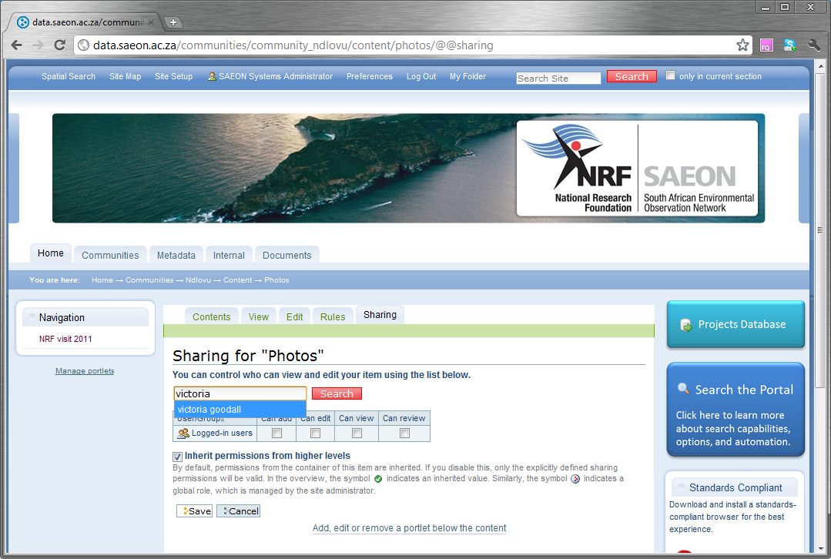
… or one can search for users to assign right to.

Slide 6
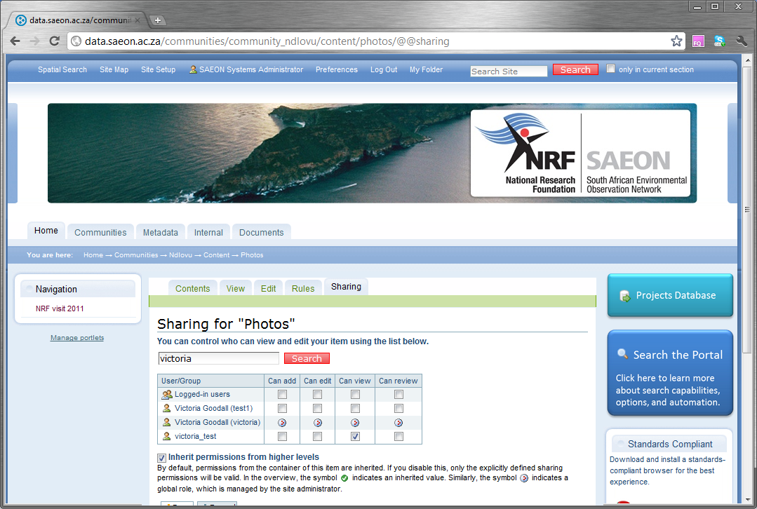
Individual User Rights
This account has inherited all privileges (‘Manager’)
This account has none, but we can grant ‘View’ privileges.

