Slide 1
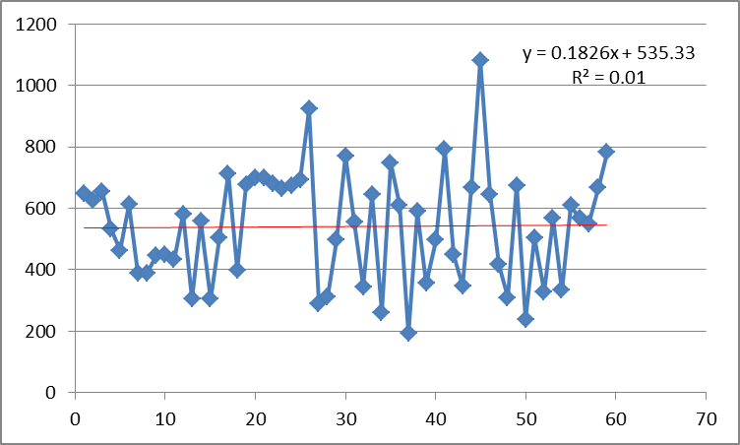
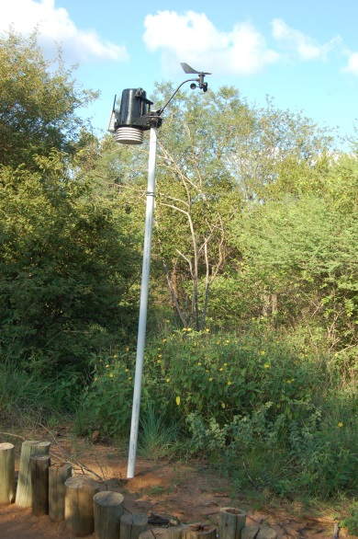
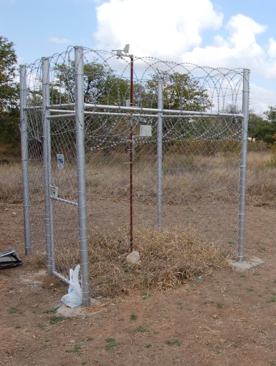
Using Weather Data in the Classroom
Dr Tony Swemmer
SAEON Ndlovu Node

Slide 2
OUTLINE
Background on SAEON
The automatic weather station
What does it measure?
Retrieving the data
Reading graphs
Working with data from the station
Weather
Daily patterns
Rainfall events
Effects of weather – rainfall and grass growth
Extension: combining with other data
Climate
Long-term patterns for Phalaborwa
Comparing with other towns
Climate change

Slide 3
The South African Environmental Observation Network
A comprehensive, sustained, co-ordinated and responsive South African earth observation network that delivers long-term reliable data for scientific research and informs decision-making
A network, not a funding organization
Facilities for long-term research
Co-ordination
Synthesis
www.saeon.ac.za

Slide 4
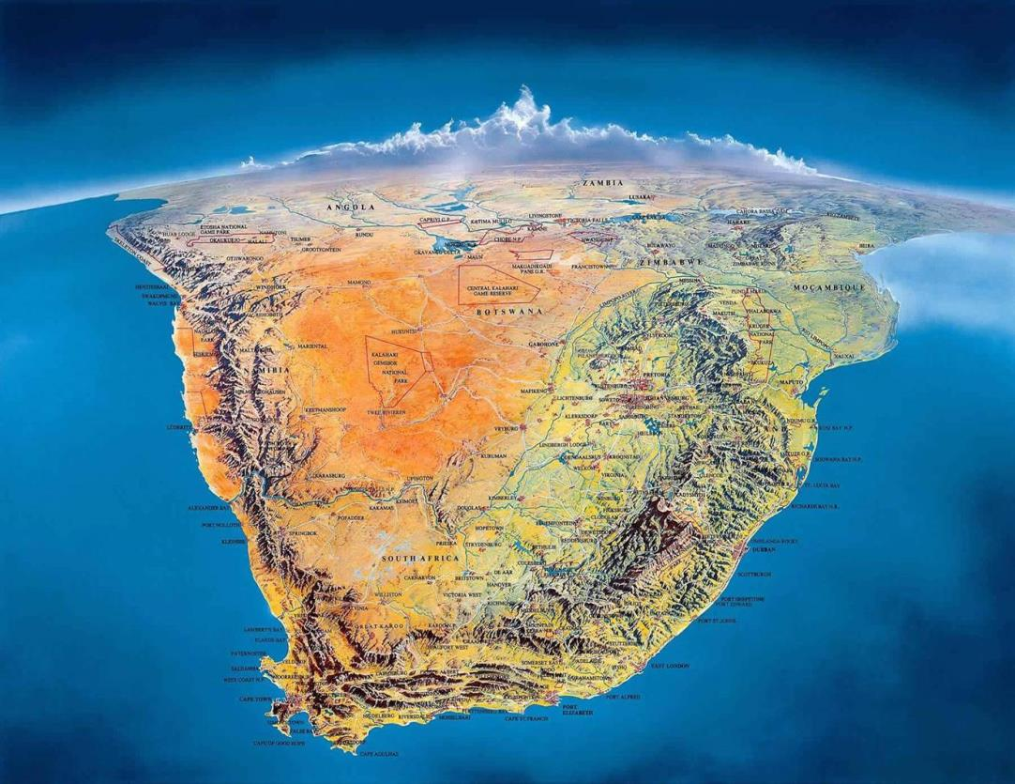
SAEON Nodes
National Office
Arid Lands
Savanna
Grasslands /
Forests/
Wetlands
Marine-Offshore
Coastal-Inshore
Fynbos

Slide 5
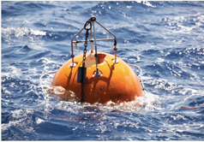
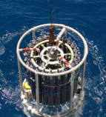
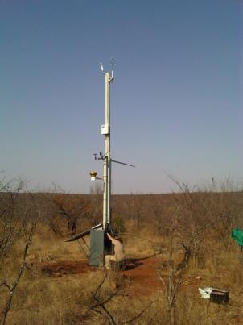
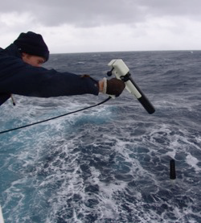
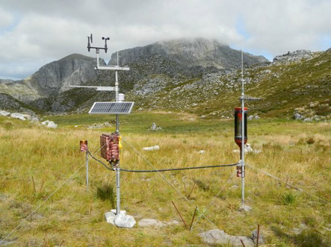
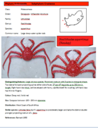
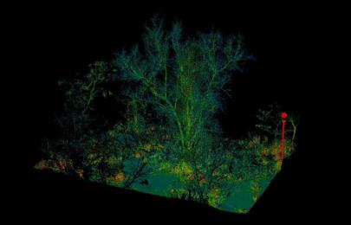
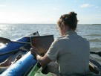
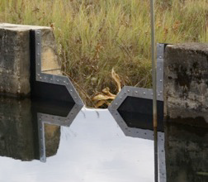
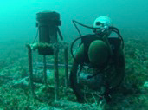
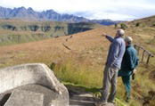

Slide 6
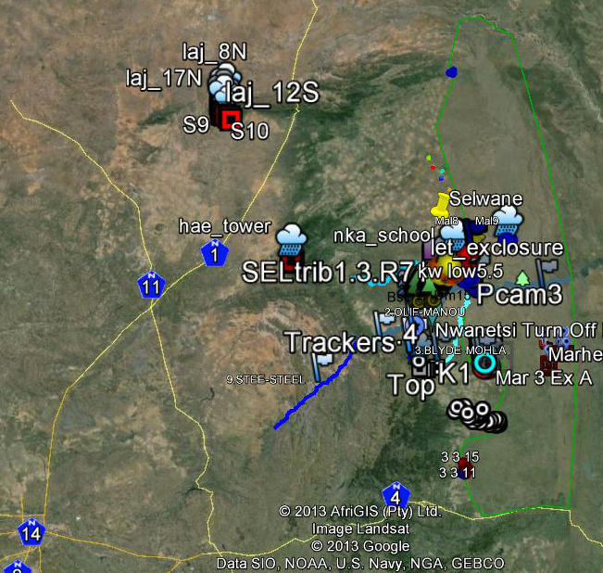
SAEON Ndlovu Node

Slide 7
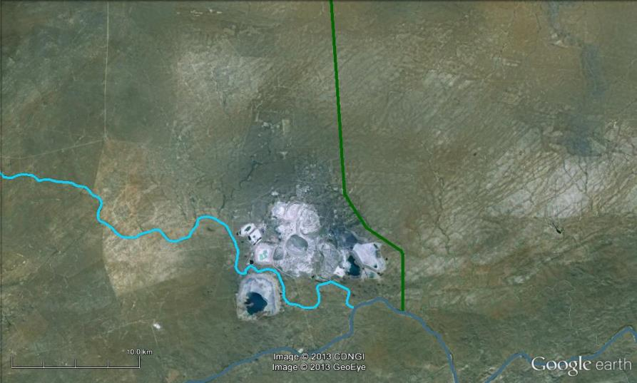
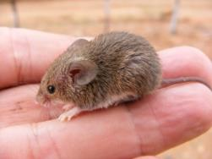
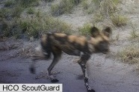
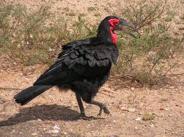
Phalaborwa area
How do LAND USE and GLOBAL CLIMATE CHANGE affect the natural environment?
biodiversity
ecosystem services

Slide 8
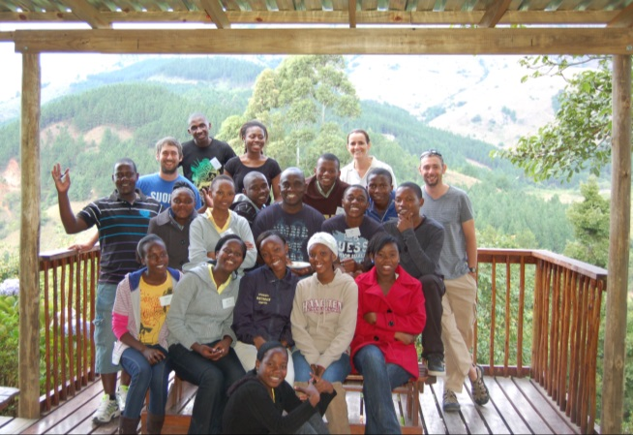
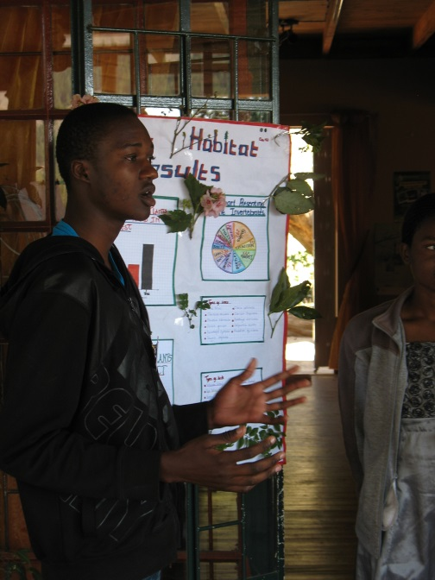
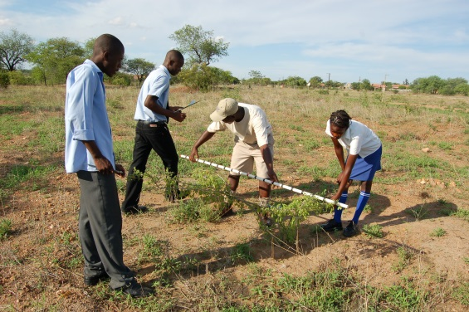
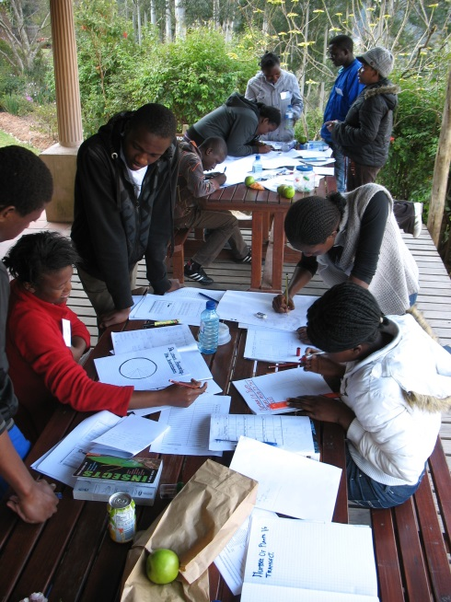
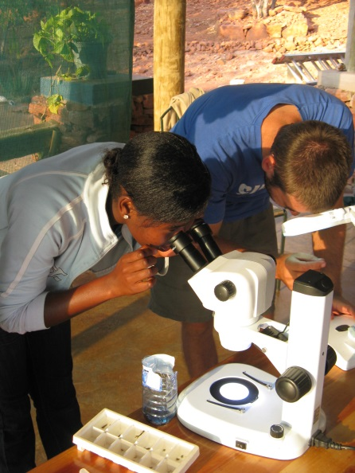
EDUCATION OUTREACH
Science camps
Grade 11 (2010 - )
Grade 10 (2010 - )
Grade 9 (2011 - )
Grade 8 (2013 - )
School-based projects
Educator workshops
Science awareness
Support for NSW
Demostrations for university students

Slide 9
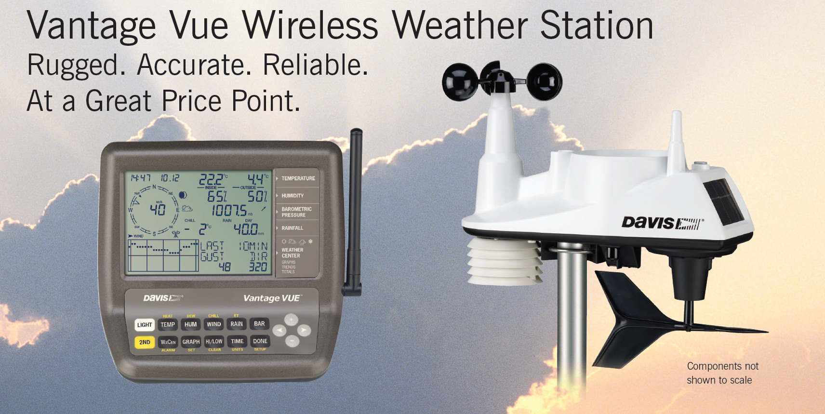
SCHOOL BASED PROJECT: WEATHER & CLIMATE

Slide 10
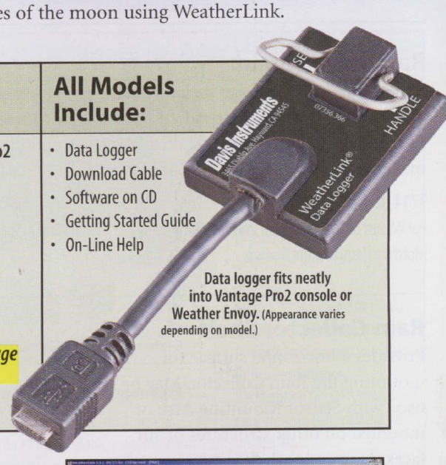
Data
Station sends data to console every 2.5 seconds
Console writes data into memory on Data Logger
When you connect with cable, data is downloaded onto your computer

Slide 11
Using the data
Read directly off console
Weather link software
Microsoft Excel
download as text file
open text file in Excel

Slide 12
WEATHER
Weather = current condition of the atmosphere
Daily patterns
rainfall
min and max temperature
relative humidity
Weather events – Rainfall
weather before and after rainfall
examine previous rainfall events to explain process of storm formation

Slide 13
WEATHER. EXERCISE 1: Daily Data
Learners record data every day
either off console, or off WeatherLink on computer
teacher assists with data for weekends (from downloads)
Examine data to answer basic questions:
what day was the hottest this week / month / year?
how much rainfall last month?
on what day was the lowest minimum temperature recorded?
was is the difference between the temperature inside and outside?
Notes:
See Excel spreadsheet for example

Slide 14
WEATHER. EXERCISE 2: Rainfall Events
Read graphs off WeatherLink to investigate how weather changes before and after a storm passes
aim is to demonstrate changes in the weather that lead to the formation of clouds and rainfall
Should see:
high temperatures for one or two days
rapidly falling air pressure
then rises as storm passes
wind initially from N or W
then swings to SE as storm passes

Slide 15
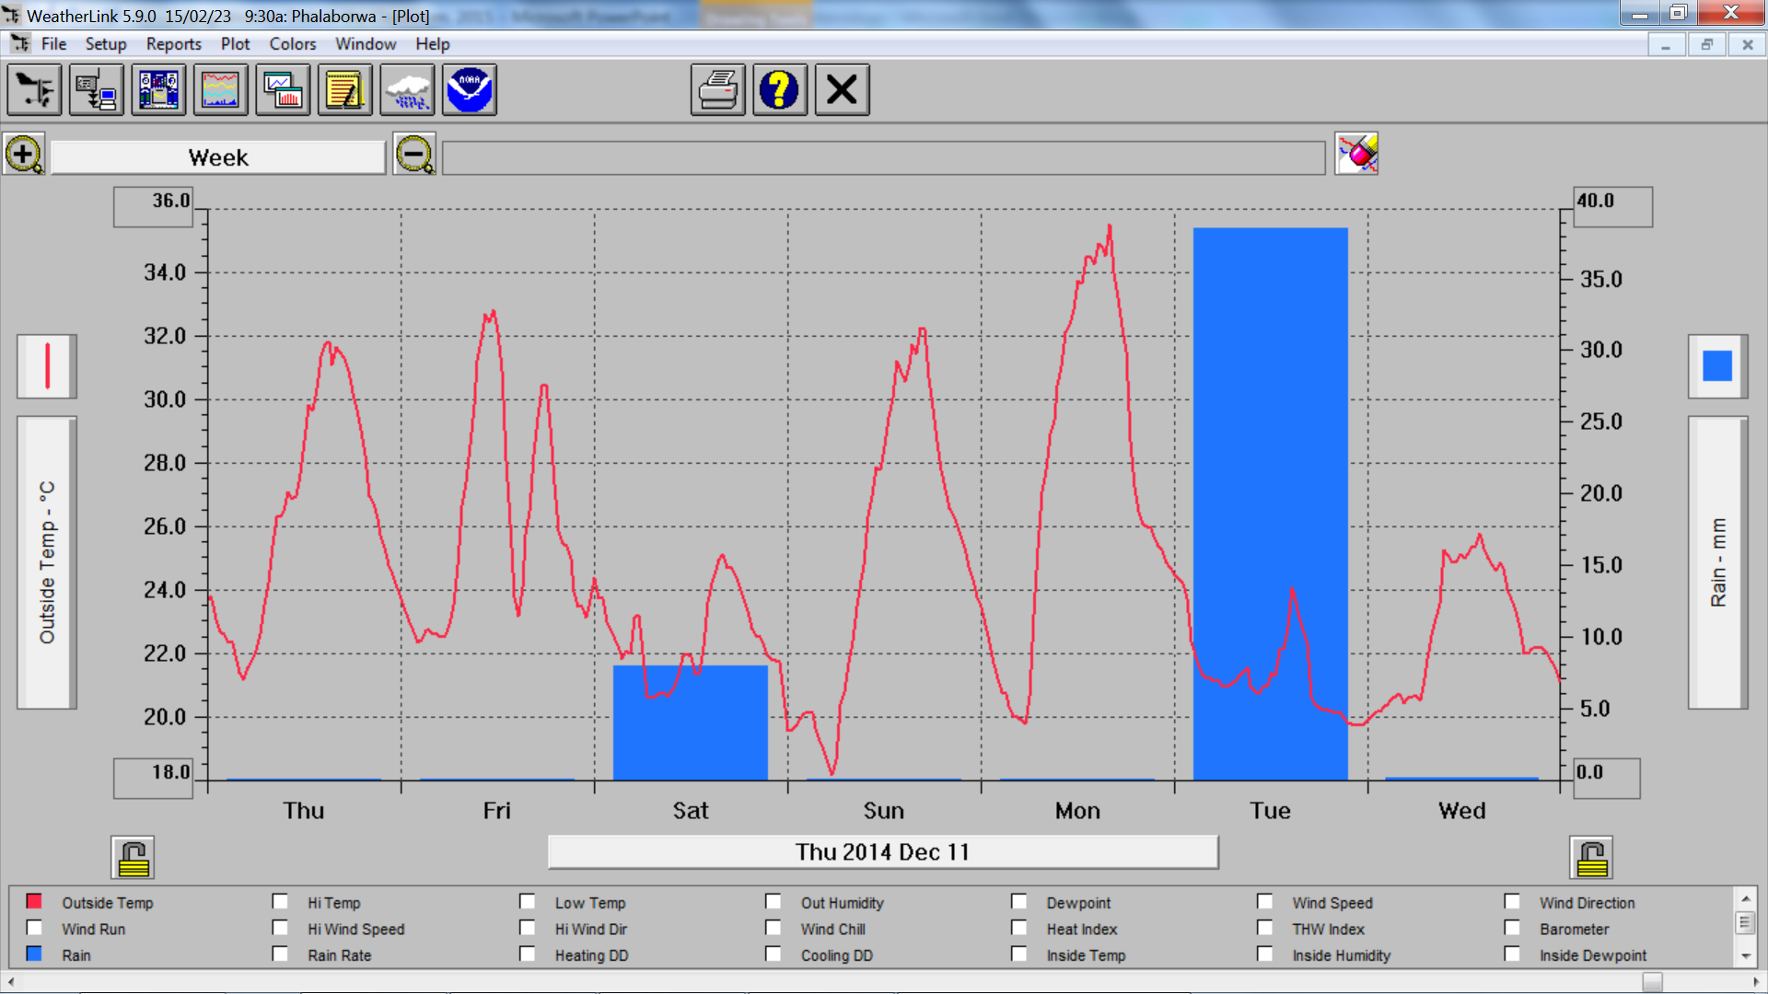
WEATHER. EXERCISE 2: Rainfall Events
Notes:
Graph shows two storm events that passed in December 2014. Note high temperatures the day before the rainfall.

Slide 16
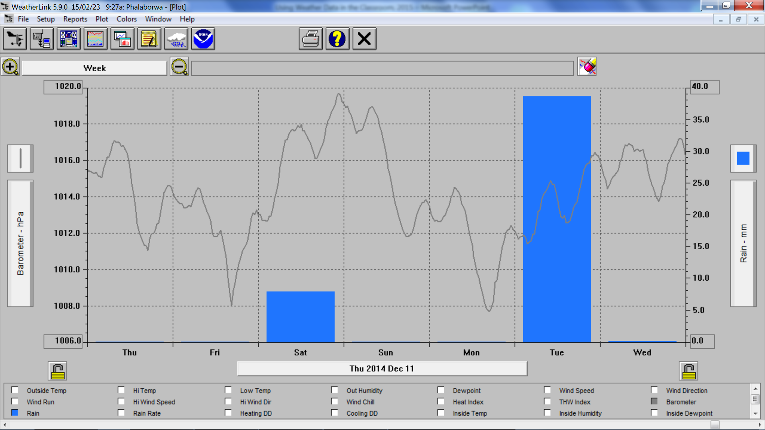
WEATHER. EXERCISE 2: Rainfall Events
Notes:
Declining air pressure before storms, and rapidly increasing pressure during and after.

Slide 17
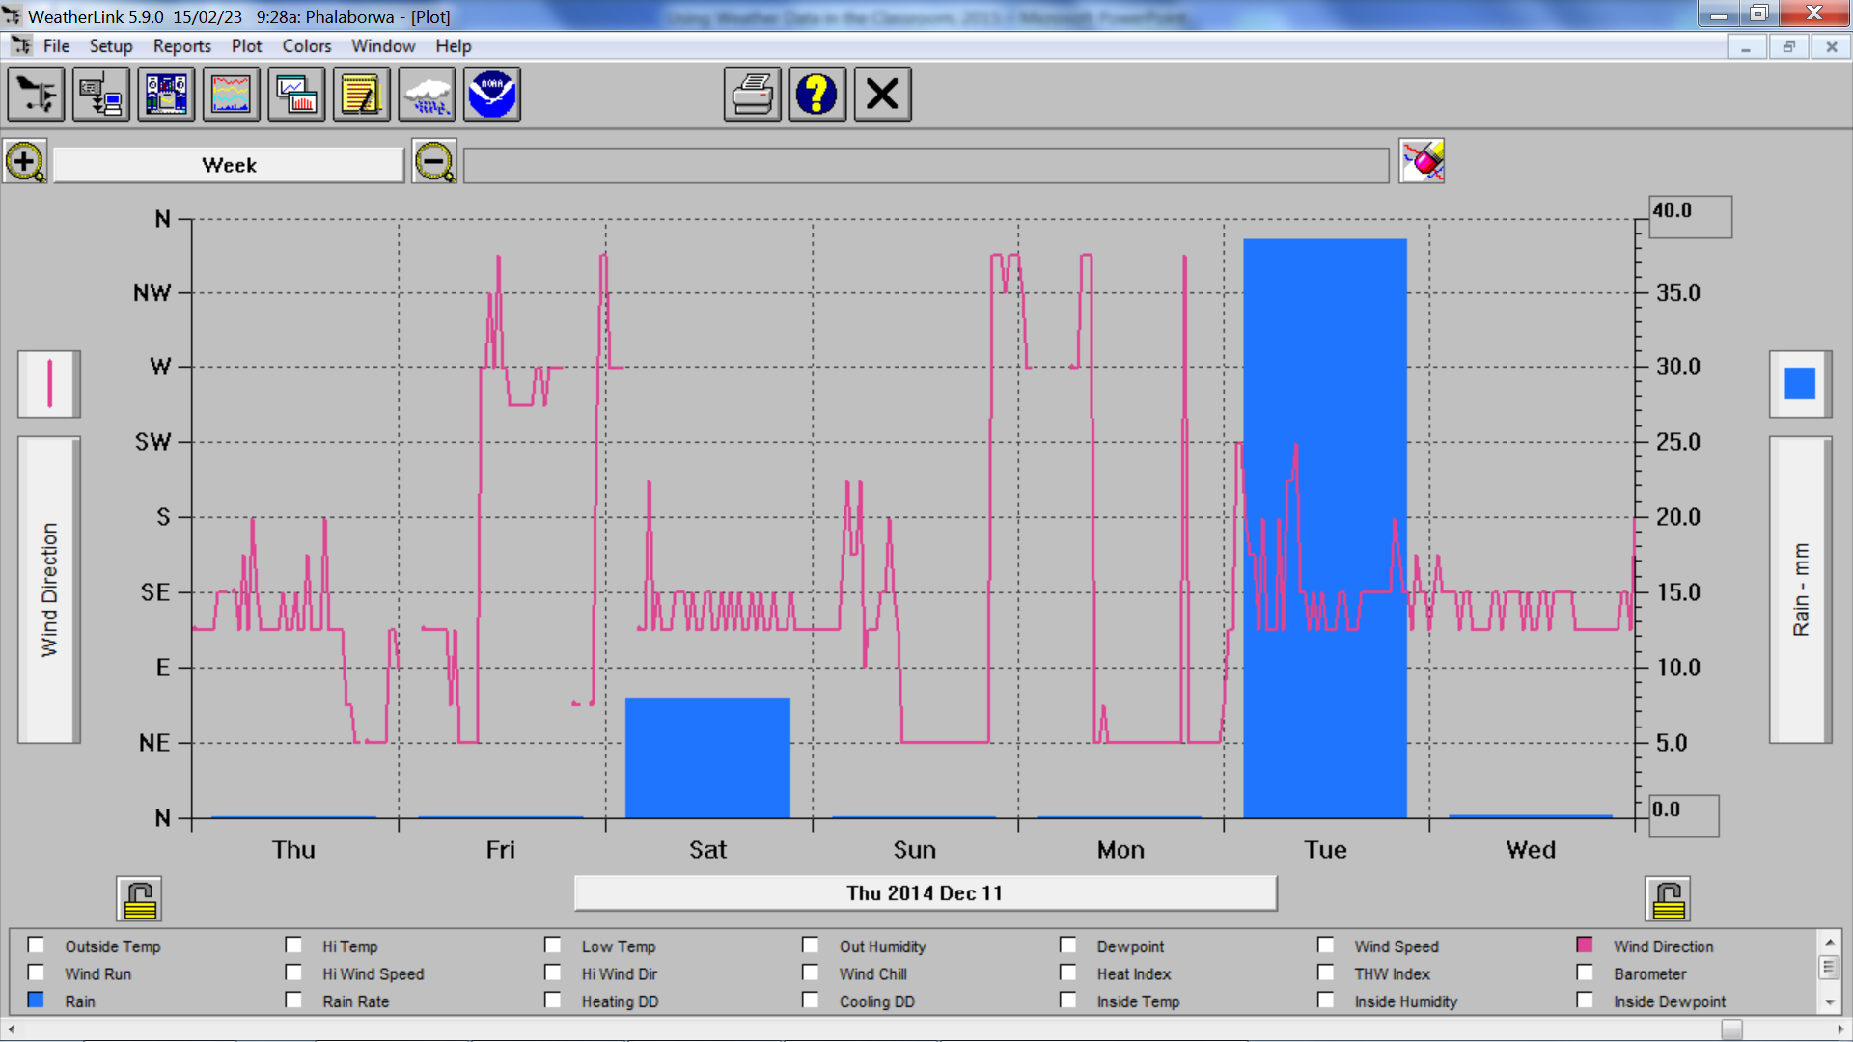
WEATHER. EXERCISE 2: Rainfall Events
Notes:
With winds blowing from the N, NW or NE before the storms, and then changing rapidly to SE as the storm system passes.

Slide 18
Extension
Using weather station data in combination with other data
Weather
Forecasts
Explain how computers are used to model the weather (difficult!)
Problems with weather forecasts
test accuracy of local weather forecasts
Climate
Phalaborwa
Comparing Phalaborwa with other areas in our region
reasons for differences
Climate change
Phalaborwa trends
Interview members of local community

Slide 19
WEATHER. EXERCISE 3: Forecasts
Record predictions made on TV or internet
for maximum temperature and rainfall
for 1, 2, 3, and 4 days ahead
use table or Excel
Then record actual weather recorded by weather station
Calculate differences between prediction and actual
Should find difference in accuracy between temperate and rainfall predictions
Should find accuracy is very low more than 1 or 2 days ahead
Notes:
See Excel spreadsheet for example

Slide 20
CLIMATE. EXERCISE 4: Phalaborwa Climate
Climate = long-term, average condition of atmosphere (usually averaged over 30 years or longer)
Use historical data for Phalaborwa (1955 to current) to answer questions about climate:
which month usually has the most rainfall?
what is the average annual rainfall?
which month is usually the hottest?
which month usually has the high temperatures?
which month usually has the lowest temperatures?
how many times has the temperature exceeded 40ºC?
Compare current weather conditions to climate records
how many times in the past has the maximum temperature exceeded today’s temperature?
Notes:
See Excel spreadsheet for example

Slide 21
CLIMATE. EXERCISE 5: Regional Climate
How does the climate of Phalaborwa compare with other towns in our area?
And what are the reasons for these differences?
Compare averages for:
annual rainfall
monthly max temp
monthly min temp
Check if weather matches differences seen
using forecasts on internet

Slide 22
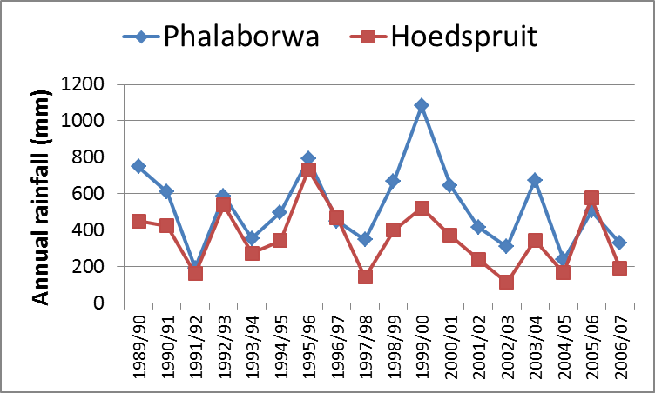
CLIMATE. EXERCISE 5: Regional Climate
18 year average: Phalaborwa = 525mm, Hoedspruit = 358mm
Notes:
Phalaborwa received more rainfall almost every year between 1989 and 2007. Why does Phalaborwa get more rainfall than Hoedspruit?

Slide 23
CLIMATE. EXERCISE 6: Climate Change
Is the climate of Phalaborwa changing?
Study literature on global climate change.
what are the predicted changes for our area?
Analyse historical data for change
annual rainfall
maximum temperatures
minimum temperatures
Should see that large variability in weather from one year to the next makes it very difficult to detect change

Slide 24
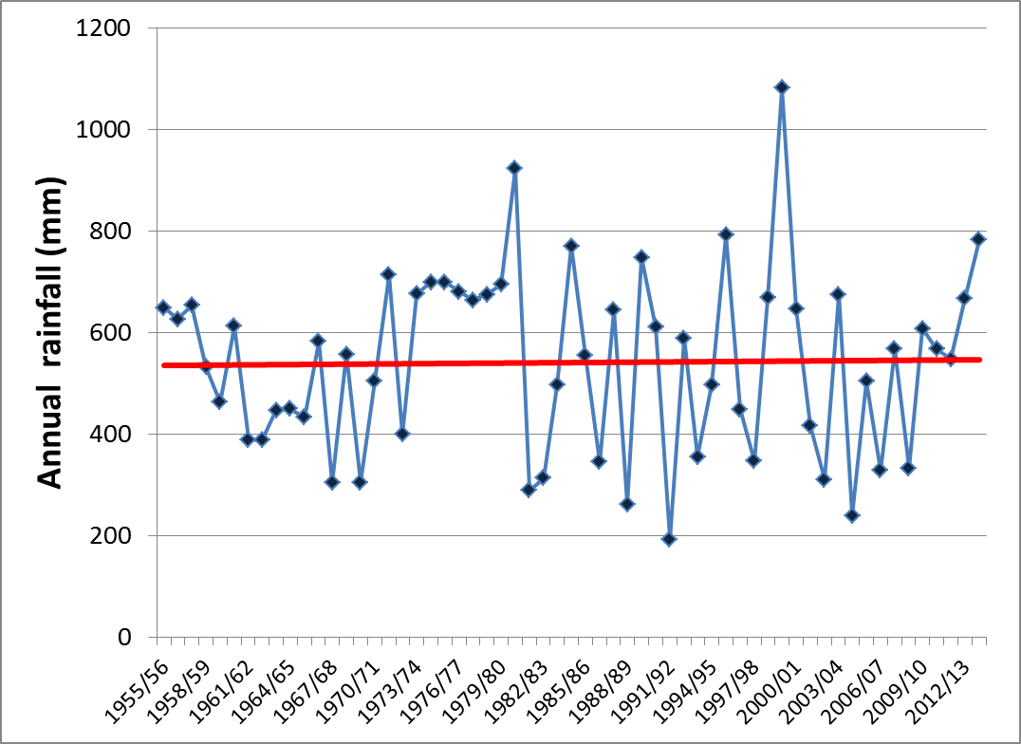
CLIMATE. EXERCISE 6: Climate Change
Phalaborwa Rainfall (1995 to present)
Notes:
No long term trend in rainfall for Phalaborwa, but there are short term trends lasting about 10 years (see next two slides). Rainfall is highly variable from year to year, which makes it very difficult to determine if it is changing in the long-term. This why it is important to use many years of data (30 years or more) to determine the average climate, and to determine if the climate is changing.

Slide 25
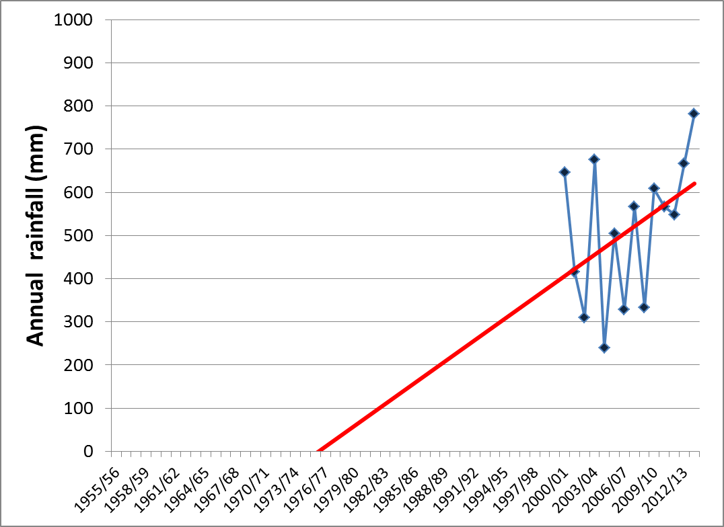
CLIMATE. EXERCISE 6: Climate Change
Notes:
If we only use the data for the 2000 to 2010 decade, it appears as though rainfall is increasing…

Slide 26
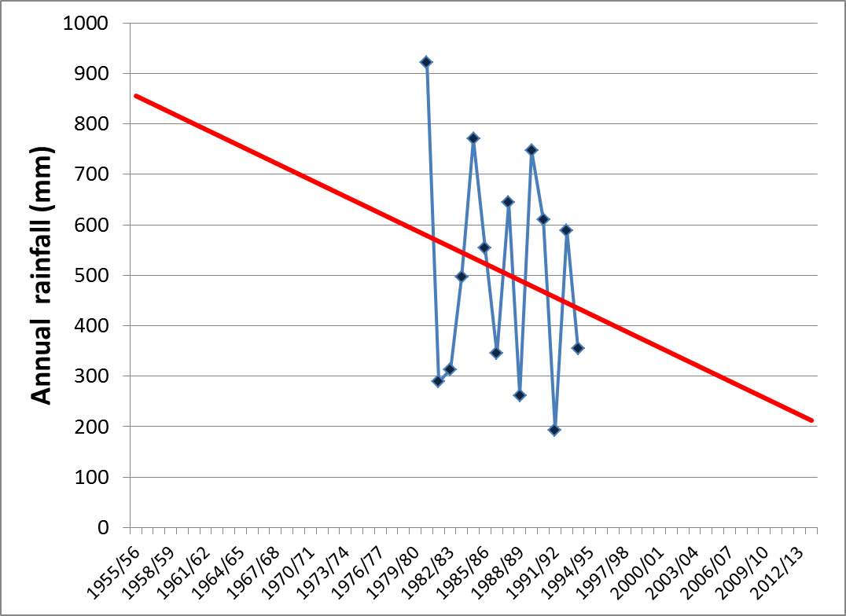
CLIMATE. EXERCISE 6: Climate Change
Notes:
… but if we look at only the data for the 1980’s, it appears as if rainfall is decreasing.

Slide 27
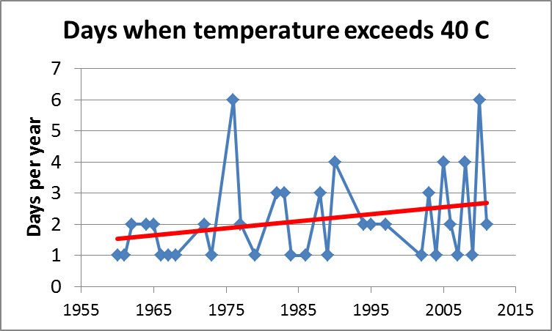
CLIMATE. EXERCISE 6: Climate Change
Notes:
Temperate does seem to be changing in the way predicted by global climate change models, i.e. high temperatures and more heat waves. This graph shows that the number of days in a year when the max temp goes about 40C is gradually increasing.

Slide 28
Other ideas
Reading synoptic charts
daily charts available on internet
compare with wind and pressure recorded at school
Relating weather to society
measure growth of fruit trees / crops in home gardens, and relate to weather
compare annual rainfall to grass production
interview members of local community to ask if they think the climate is changing
particular those affected by rainfall (e.g. small-scale farmers, game farm managers)

Slide 29
WAY FORWARD
Installing and maintaining stations
downloading data?
which teacher at your school will be responsible?
Develop current exercises?
Computer-based (Excel) or paper-based?
More ideas for classroom exercises / projects
ESKOM and TriTech projects
We can assist learners with projects that make use of weather or climate data
Notes:
Will send a list of topics for potential ESKOM / TRITECH projects.

Slide 30
USEFUL WEBSITES
Weather forecasts
http://weatherphotos.co.za
http://www.yr.no/place/South_Africa/Limpopo/Phalaborwa_Hek/
http://www.windfinder.com/forecast/phalaborwa
http://www.weathersa.co.za/
Ideas for classroom lessons or projects
http://www.srh.noaa.gov/jetstream/matrix.htm
http://www.metlink.org/wp-content/uploads/2013/11/work_schemes/lesson2_pritchard.pdf
https://www.teachengineering.org/view_activity.php?url=collection/cub_/activities/cub_weather/cub_weather_lesson04_activity1.xml
http://www.weatherwizkids.com/weather-experiments.htm
Info on global climate change
http://eo.ucar.edu/educators/ClimateDiscovery/ESS.htm
http://www.wunderground.com/climate/
https://www.koshland-science-museum.org/explore-the-science/earth-lab#.VO13C3yVI9Y

