Slide 1
Beyond Meta-Data: Nano-Publications Recording Scientific Endeavour
Wim Hugo – ICSU-WDS/ SAEON

Slide 2
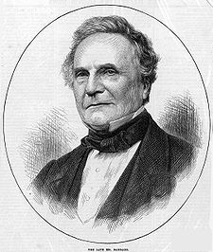
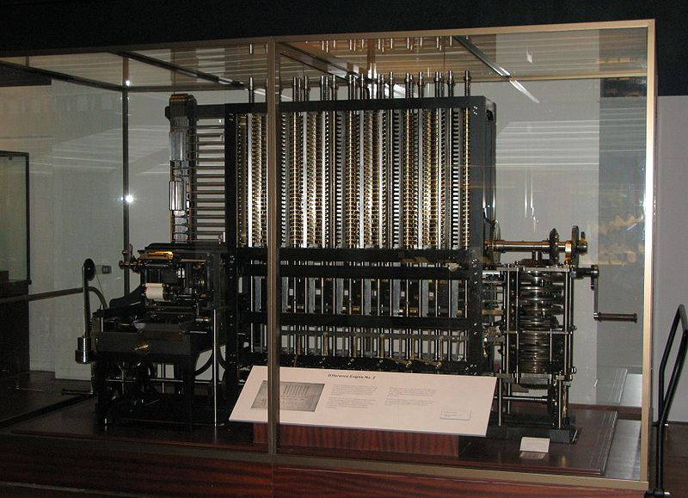
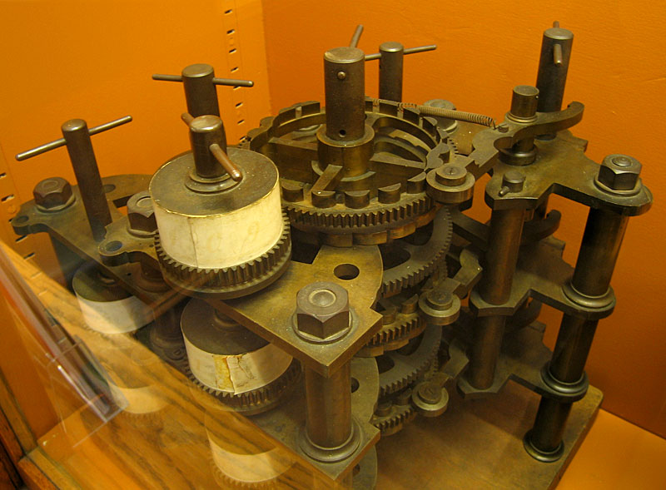
Charles Babbage (1791-1871)

Slide 3
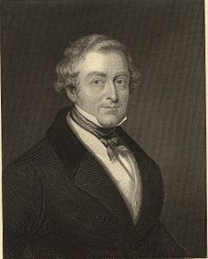
Sir Robert Peel (1788-1850)
The British Parliament, after investing £ 20,000 in the Difference Engine project, was treated to a demo.
£ 2,200,000 in 2013
“Can you set the machine to calculate the time at which it will be of some use???”

Slide 4
Part I: The Internet

Slide 5
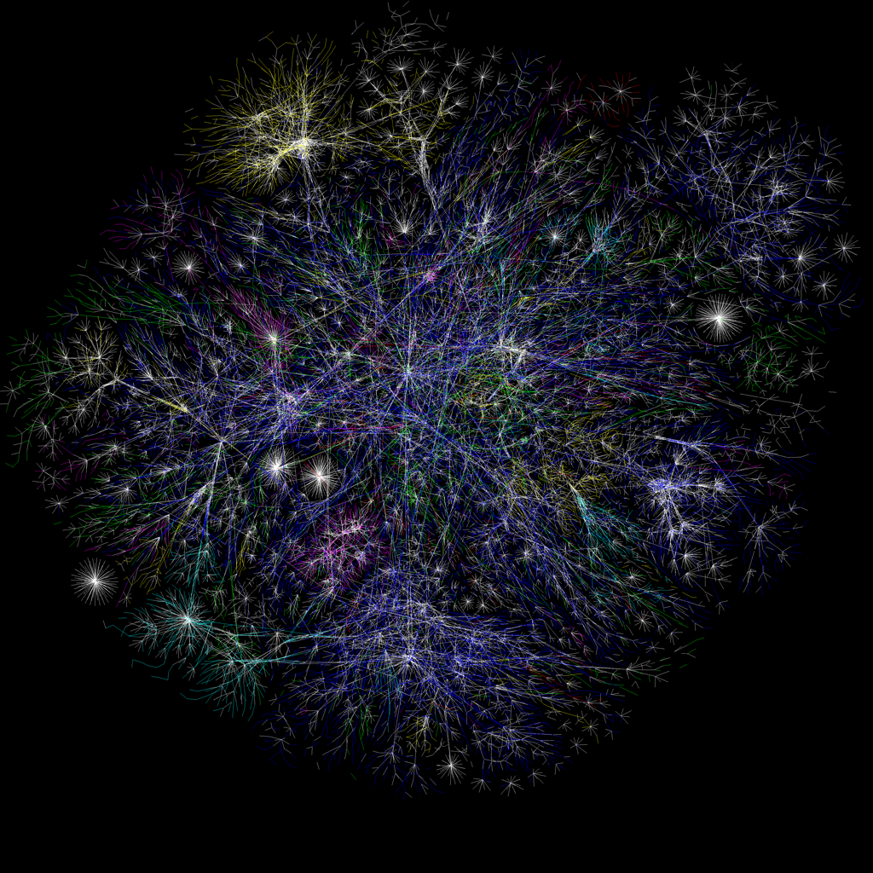

Slide 7
The OPTE Project 2005
LUMETA
Roughly 30% of all known IP addresses
Continuous IPv4 and IPv6 mapping

Slide 8
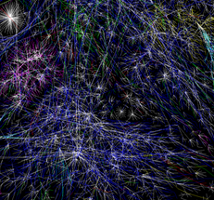
We can say that …
There is an emerging, but hidden global research data infrastructure
Driven by changes in the way we work
Opens up new possibilities in research methods and approaches
Also contains information on scientific endeavour and the supporting fabric of that endeavour
Three elements
Text mining focused on scholarly publication
Structuring via PIDs
Largely untapped: mining meta-data and published scientific data, plus some enhancements

Slide 9
The Internet with Implied Relationships
At each physical node, multiple documents or services
In each document or service, multiple semantic elements of interest
Between each pair of semantic elements, potentially one or more named relationships
Relationships are explicit or implied

Slide 10
Too Large and Complex to be Useful…
The Complete Web: every piece of information at a physical network node is potentially in multiple relationships with every other. This enormous graph is many times larger than the physical internet ⁽¹⁾ and is not practically useful for science.
Formal Meta-Data: very few links are formally specified, eliminating almost all of the potential links between pieces of information to favour only a very rigid collection.
(1) Fensel, D. and van Harmelen, F. (2007). Unifying Reasoning and Search to Web Scale, IEEE Computer Society, 1089-7801/07. http://www.cs.vu.nl/~frankh/postscript/IEEE-IC07.pd f

Slide 11
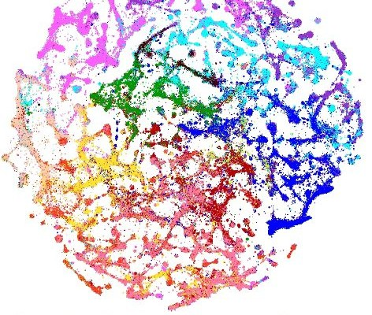
Many of you are intimately involved …
‘Web of Science’
&
‘Atlas of Science’
work –
Börner, Boyack, Klavans,
and collaborators
Focused on clustering
and free text mining
Already billions of
triples available in
data
Boyack, K and Klavans, R (2013).
Preprint of article accepted in Journal of the American Society for Information Science and Technology

Slide 12
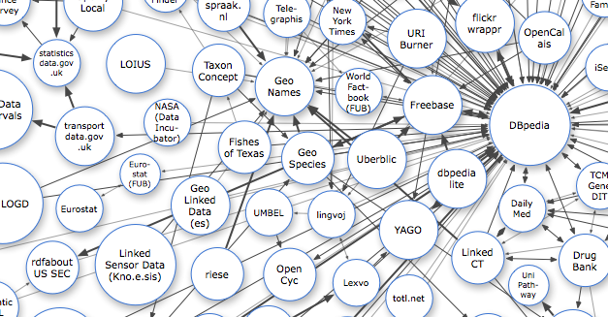
Growing Links to Scientific Data …
http://richard.cyganiak.de/2007/10/lod/imagemap.html

Slide 13
Complexity
In a completely connected network, complexity quickly grows: c=½n(n-1) ~ =½n²
n=3
c=3
n=4
c=6
n=5
c=10
n=6
c=15

Slide 14
Effects of Layering (Clustering)
Reduction in Complexity
n=6
c=15
n=3
c=3
n=3
c=3
c=1
c=1+3+3=7
Note diminishing benefit from increased levels of clustering
Cluster Levels

Slide 15
Hypothesis: The Sweet Spot
← Low ‘linkedness’ High ‘linkedness’→
Probability that
match will
be found
Probability that
match will
be useful
Probability that
match will
be found
Probability that
match will
be useful
Maximum
Utility
Maximum
Utility
Increasing Probabiliy →
Typical Science
Gateway/ Portal
Typical Science
Portals
Typical Search
Engines
“Ideal”
Typical Search
Engines
“XXX”
Unit Cost of Service
Unit Cost of Service
Increasing inclusiveness , reduced structure, or widening mandates →

Slide 16
Measures to Reduce Complexity
De-Duplication:
achieved through ontologies or vocabularies, registries
reduces the number of nodes
Layering: measures to
eliminate non-essential or duplicate relationships
and to group nodes together through ontology or entity modelling
Reduced Resolution:
Some relationships are stronger than others
disregard the weakest to obtain an approximation

Slide 17
Part II: The ICSU World Data System
ICSU Programme – established 2008
Replaces ‘World Data Centers’ – inception in the 1950s with International Polar Year
Quality-assured data and services – scientific data for science
Evaluates Governance, Technical Maturity, Sustainability, Outreach
http://www.icsu-wds.org

Slide 18
Trusted Data Services for Global Science
As an ICSU Interdisciplinary body, the mission of the World Data System is to support ICSU’s vision by promoting long-term stewardship of, and universal and equitable access to, quality-assured scientific data and data services, products, and information across a range of disciplines in the natural and social sciences, and the humanities. WDS aims to facilitate scientific research under the ICSU umbrella by coordinating and supporting trusted scientific data services for the provision, use, and preservation of relevant datasets.

Slide 19
Global Research Data Infrastructure
Make trusted data services an integral part of international collaborative scientific research
Nurture active disciplinary and multidisciplinary scientific data services communities
Improve the funding environment
Improve the trust in and quality of open Scientific Data Services
Position ICSU-WDS as the premium global multidisciplinary network for quality-assessed scientific research data

Slide 20
The Vision and Positioning of WDS
Registry of Trusted Digital Repositories and Services
Persistently Identifiable, Citable Data Sets
Registries of Actors and Systems
WDS Membership
DataCite
CrossRef
ORCID
re3Bib
Belmont Forum
Registries of Journals and Publications
Research Institutions
Initiatives and Projects
RDA: DSA
RDA

Slide 21
The Problem with Meta-Data
No incentive
But this is changing …
Structured and Rigid
Partial Description of Scientific Endeavour
Unlikely to Converge
Cross-Disciplinary Challenges

Slide 22
Traditional Meta-Data is mostly hierarchical …
Meta-Data
Citation
Title, Abstract and Publisher
Author(s)
Coverage
(Temporal, Spatial, Topic)
Institution
Use, Caveats, Lineage, Methods, and Licenses
Institution
(Online)
Resource(s)
Quality and Metrics
Meta-Data
Management
Meta-Data
Author(s)

Slide 23
Liberalised Meta-Data is a graph
Publisher
People
RDI Outputs/ Online Resources
Coverage
(Temporal, Spatial, Topic)
Citation
Institutions
Projects
Initiatives
Use, Caveats, Lineage, Methods, and Licenses
Networks
Funders
Relationships are contributed by (1) meta-data mining (2) information from websites conforming to schema (3) social-media-type sites and VREs (4) existing network contributions (5) scraping existing websites (6) ontologies and vocabularies (…)

Slide 24
Create a KN from Meta-Data Triples
Define a conceptual model for the aspects of knowledge networks that we want to manage.
This fixes the relationships between elements of such networks: people, institutions, funders, projects, collaborations, data, services, publications, etc. By eliminating some possible (but improbable) relationships, complexity is reduced.
The conceptual model extends meta-data standards, and ‘Insitution X’ should actively promote the more informal contributions to this resource.
‘Insitution X’ maintains a repository (registry) of network-defining extended meta-data (RDF/a Triples) as a public good.
The conceptual model can draw on and extend resources such as schema.org
Major Side Benefit: Triple-based meta-data will, in time, become standard-independent but be capable of mapping to any standard

Slide 25
Real-Life Examples SAEON Meta-Data base: ± 7 000 records WDC-BHH Meta-Data base: ± 22 000 records
WDC
SAEON

Slide 26
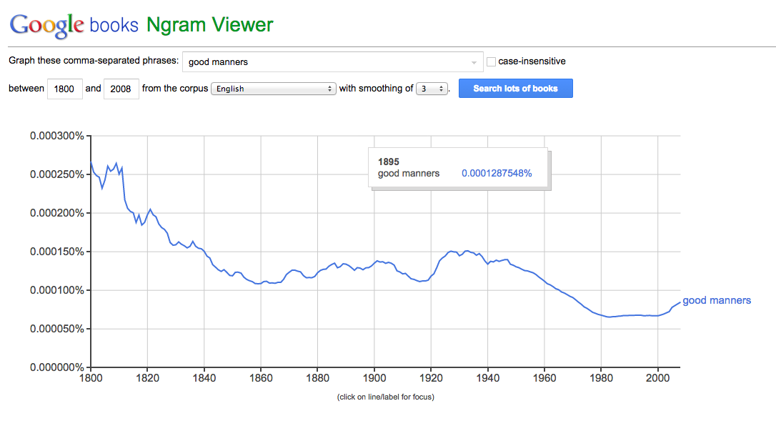
Some things are out of fashion …

Slide 27
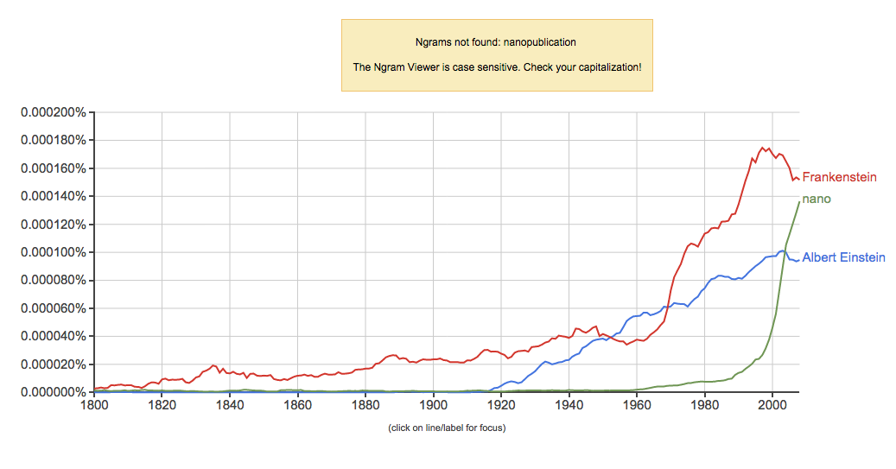
Nano-publication: Machine-Actionable
http://www.slideshare.net/hvdsomp/towards-a-machineactionable-scholarly-communication-system

Slide 28
What Must Be Done?
Current Situation
Meta-Data Collection
Aggregated
Repository
e.g. WDS
Meta-Data Collection
Meta-Data Collection
Aggregated
Repository
Meta-Data Collection
Aggregated
Repository
Meta-Data Collection
Meta-Data Collection

Slide 29
What Must Be Done?
Current Situation
Nano-Publication
Publications and Citations
Meta-Data Collection
Aggregated
Repository
e.g. WDS
Free Text
‘Web of Science’
Meta-Data Collection
Meta-Data Mining Tools and Projects
Meta-Data Collection
Aggregated
Repository
schema.org –type scrapers
Knowledge Networks Repositories
Meta-Data Collection
Network/ Institutional contributions
Aggregated
Repository
Other RDF and LOD Resources
Meta-Data Collection
Voluntary contributions
Meta-Data Collection
Meta-Data Automation and LOD
BILLIONS of smart devices

Slide 30
What Must Be Done?
Supporting Standards, Schema, and Specifications
linked to a Reference Model
Maintain Inventory of Sources
Publications and Citations
Free Test
‘Web of Science’
Visualisation and Traversal
Meta-Data Mining Tools and Projects
schema.org -based scrapers
Knowledge Network Repositories
Tools for Query and Retrieval
Mediators/ Judgment Tools
Network/ Institutional contributions
Other RDF and LOD Resources
Voluntary/ Crowdsourced contributions
Create and Operate Repository
Build Reference Implementations
BILLIONS of smart devices

Slide 31
What must be done?
Content Standards
Trusted Digital Repositories
Named relationships (edges)
Service standards
Knowledge Network Services
Translator Services
User
Interfaces
Gateway
Services
Add
Edit
Delete
Query
MetaData
Citations
People
…
Visualisations
Search/ Discovery
Mediation
Reporting
Funders
Institutions
Researchers
Initiatives
…

Slide 32
Part III: ICSU WDS Knowledge Network
Establish or Promote Critical Components
Provide “Glue”
Two-Pronged Approach
Build, Operate, Improve
Community Consensus

Slide 33
Main Elements of GRDI Soft Infrastructure
People
RDI Outputs
Institutions
Projects
Initiatives
Networks
Funders
RDI: Research, Development and Innovation

Slide 34
What GRDI is NOT
NOT created by voluntary contributions
NOT operated through grants and projects
NOT a research task
Sustainable Funding Models
Long-Term Government Funding
Free combined with Premium Services
Membership Contributions

Slide 35
Main Process of GRDI Soft Infrastrcuture
Data
“Bind”
Visualise
Data
Analysis
Mediator
“Publish”
www
www
Process
Meta-Data
Discovery
Assess
Meta-Data
“Find”

Slide 36
Role of WDS
WDS should develop critical parts of the infrastructure by
Integrating existing initiatives and implementations
Developing interface and ‘knowledge snippet’ (triple) specifications
Providing a repository for knowledge snippets and registries
Registries include
Trusted Digital Repositories (in collaboration with DataCite and DSA).
Conformant Network Elements (e.g. ORCID, DataCite, …)

Slide 37
Typical Network Elements
Trusted Digital Repositories
Publisher
People
RDI Outputs/ Online Resources
Coverage
(Temporal, Spatial, Topic)
Citation
Institutions
Projects
Initiatives
Use, Caveats, Lineage, Methods, and Licenses
Networks
Funders
Relationships are contributed by (1) meta-data mining (2) information from websites conforming to schema (3) social-media-type sites and VREs (4) existing network contributions (5) scraping existing websites (6) ontologies and vocabularies (…)

Slide 38
Design Considerations
Diversity of initiatives, projects, and established interests all contribute to and/ or own parts of the network
No apparent long-term funder for the entire network
Only realistic scalable operation is through crowdsourcing/ small contributions by many, in the style of social networks

Slide 39
Problem Statement
Monolithic solution will not work
Network is disperse and cannot be exploited by humans/ machines in a uniform way
Contribution is constrained by lack of channels conforming to widely accepted standards
Registry of standards-compliant sub-network components will be required
Computational challenges – distributed and large

Slide 40
Existing Initiatives – Knowledge Network
TDRs
(WDS, DSA, DataCite*)
Publishers
(CrossRef?)
People
(ORCID)
RDI Outputs/ Online Resources
Coverage
(Temporal, Spatial, Topic)
Citations
(DataCite)
Institutions
(?)
Projects
Initiatives
Use, Caveats, Lineage, Methods
Networks
Licenses
(CoDATA, Creative Commons)
Funders
(?)
* Including re3data, DataBib
Exists
Maybe
Not Now
WDS

Slide 41
Use Case Family 1:
A science funding entity is assessing proposals for an international science programme/collaboration. They would like to evaluate aspects/merits of proposals in terms of:
Data publication/sharing (by understanding the character of the networks; extent or reach of that sharing),
Data archiving (by understanding the accreditation (if any) of nominated repositories; their affiliations; their reputation),
Development of data products (by understanding synergies with existing products; any duplication with other similar products),
Novelty of the science with respect to what has gone before and what is happening now (by understanding publication history in the topic area; data produced in topic area; obvious gaps that need to be addressed)
Customer: Belmont Forum

Slide 42
Use Case Family 2:
A funding entity wishes structure a call for proposals. They might want to:
Understand data gaps by topic; spatial data distribution; in time; by parameter, etc.,
Channel data/ products through specific available infrastructure/ networks to help build/ enhance them, so need to know what exists and their capabilities.
Customer: Belmont Forum, ICSU Future Earth Programme

Slide 43
Use Case Family 3:
A scientist wants to:
Find accredited repositories for their type of data;
Locate service providers to help with data quality control; data processing; data publication; visualisation; data mining; data integration;
Use a KN to find collaborators;
Identify Centres/ repositories using technologies, standards and topics with which they are familiar;
Look for research gaps and opportunities;
Locate data of interest by type; topic; theme; parameter; instrument; method of processing; author; publication Centre; project name etc.
Customer: All Researchers, WDS Membership

Slide 44
Supports Multiple Views
The ‘Institution’ view (people, networks, stakeholders and funders, publications, data, projects and initiatives, etc.)
The ‘Person’ view (collaborators, publications, data, projects, network participation, fields of interest, etc.) (“ScienceBook?”)
The “Project” view …
The “Data” view … links to other data sets (parents, children), citations, indices, …
The “Publication” view … links to people, institutions, data, citations, etc.
… and so on.

Slide 45
Typical Current Science Gateway
Participating Institutions
Projects and Initiatives
People
Funders
Stakeholders
News and Events
Static Resources
Publications
Network Portal
Dynamic Resources
Manually Maintained
Processes and Tools
Knowledge Objects
Dynamic Resources
Some Data and Services

Slide 46
Possible Future Science Gateway
Projects and Initiatives
Participating Institutions
People
Human Judgment
Funders
Stakeholders
Wiki
Network Portal
News and Events
Semantic Web
Processes and Tools
Automated
Judgment
Knowledge Objects
Logs/ Quality/
Metrics
Data and Services
Publications

Slide 47
Graph/ Tree Traversals

Slide 48
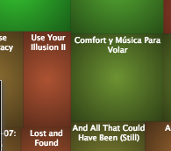
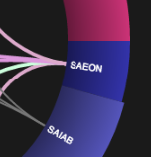
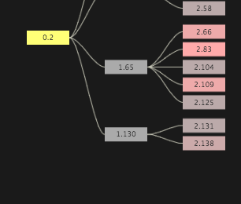
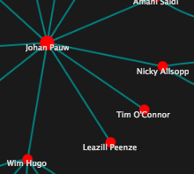
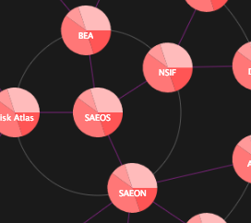
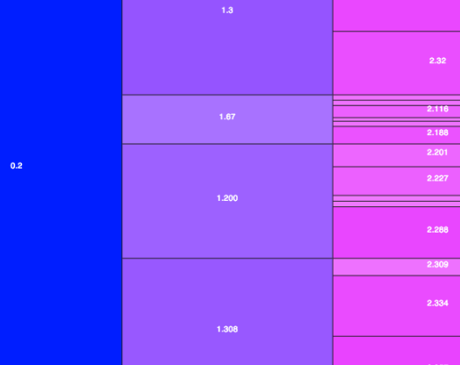
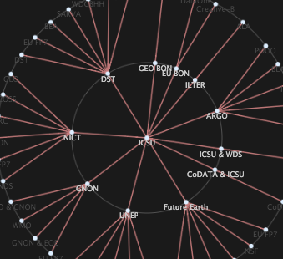
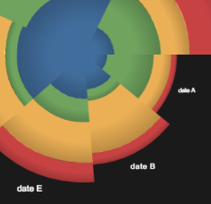
Visualisation and Traversal
InfoVis: http://philogb.github.io/jit/

Slide 49
Part IV: Blue Sky

Slide 50
Small Contributions by Many
Nanopublications
Concept was mooted by Bernard Mons at recent RDA meeting in Amsterdam
‘Push’ Service for Meta-Data
Real Tweets about Real Science
Tagging tweets to constrain them as part of the Knowledge Network?
@WimHugo
$#attending $#Knowescape, having fun, #ouzo and interesting interactions in #Thessaloniki
$#Knowescape: triples describing conference and funding programme
@Wimhugo=$#WimHugo:
triples describing researcher and link to ORCID

Slide 51
Universe of Science
‘Web of Science’ (Scholarly Publications)
WDS Knowledge Network (Quality-Assured Data)
Formal LOD Resources
…
Open KN Resources and APIs
Science-Qualified Tweets
Schema.org-compliant websites
LinkedIn, Twitter, …

Slide 52
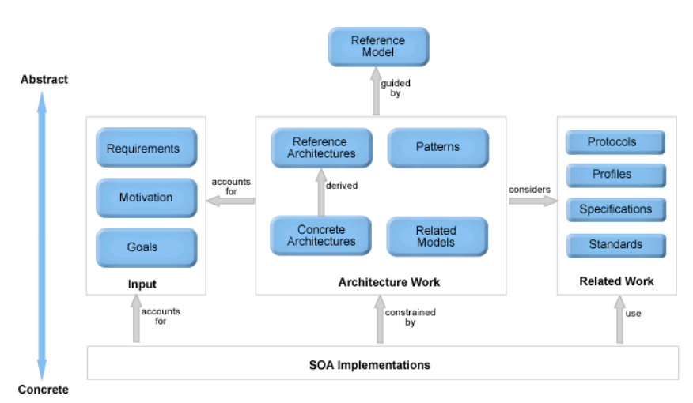
Reference Model
Network of Networks (Knowledge Networks) Implementations
Adapted from ‘Reference Model for Service Oriented Architecture’, OASIS, Committee Draft 1.0, 7 February 2006. http://www.oasis-open.org/committees/download.php/16587/wd-soa-rm-cd1ED.pdf

Slide 53
Acknowledgements
Initial World Data System Workgroup:
Kim Finney
Jane Hunter
Rob Atkinson
Peter Fox
Wim Hugo
Mustapha Mokrane
Mark Parsons
Yasuhiro Murayama
Michael Diepenbroek
RDA/ WDS Collaboration:
Yasuhiro Murayama
Wim Hugo
Michael Diepenbroek
Mustapha Mokrane
Rorie Edmunds
Please join WDS/ RDA effort to create a working group or interest group

